Slide 1

FAST MESSAGE PROPAGATION OVER IOV SCENARIOS
Dipartimento di Matematica "Tullio Levi-Civita"
Laurea in Informatica
a.a. 2018-2019
Relatore: Prof. Claudio Enrico Palazzi
Co-relatore: Dott. Armir Bujari
Jordan Gottardo 1179739
Esame di laurea - 18 Luglio 2019
1/14

Slide 2
CONTENTS
Context
Simulations
Conclusions
Context
Technologies
Scenarios
Simulation results
Extension evaluation
Future works
State of the art
My contributions
Metrics
Algorithm extensions
Conclusions

Slide 3

CONTEXT
Vehicular and Flying Ad-Hoc Networks (VANETs and FANETs)
Several applications
Smart city management
Video streaming
Traffic control
Focus: Emergency Message Distribution (EMD)
Message delivery
Timeliness
Avoid medium saturation
5

Slide 4




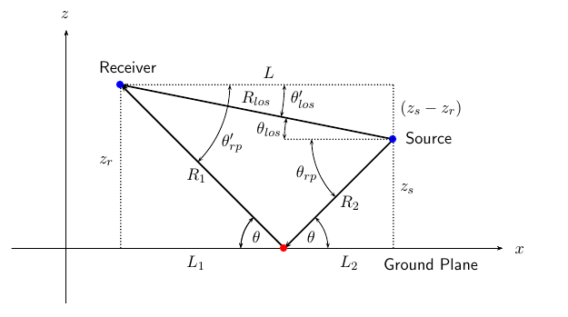
TECHNOLOGIES AND TOOLS
Expensive large scale tests
Need to use simulators (ns-3)
Additional tools and models
Real map data
Road junction modeling
Signal propagation models
Two-Ray Ground
Obstacle shadowing (with 3D extension)
5

Slide 5



FAST-BROADCAST
Multi-hop probabilistic delay-based broadcasting protocol
Dynamic transmission range estimation
No need to know it a priori, as often assumed in other protocols
Estimation Phase:
Vehicles exchange small Hello Messages (beacons) to estimate their transmission range
1 Hello Message sent every BeaconInterval (e.g., 100ms) within each transmission range
Broadcast Phase:
A
B
C
D
Waiting time | [0…1024] | [0…512] | [0…32]
5

Slide 6
ROFF (RObust Fast Forwarding)
Multi-hop deterministic delay-based broadcasting protocol
Deterministically determines the farthest forwarder
Estimation Phase:
Each vehicle sends a Hello Message every BeaconInterval (e.g., 100ms)
Neighborhood discovery process
Each vehicle builds a Neighbor Table (NBT) with one entry for each neighbor
Broadcast Phase:
A
B
C
D
Priority | 3 | 2 | 1
Waiting time | 2 | 1 | 0
5

Slide 7


FAST-BROADCAST
Multi-hop probabilistic delay-based broadcasting protocol
Dynamic transmission range estimation
No need to know it a priori, as often assumed in other protocols
Estimation Phase:
Vehicles exchange small Hello Messages (beacons) to estimate their transmission range
1 Hello Message sent every turn within each transmission range
Broadcast Phase:
A vehicle sends an Alert Message
The neighbors receive it and participate in contention to broadcast it
The vehicles farther from sender wait less time before broadcast
Waiting time depends directly on sender-receiver distance
5

Slide 8
ROFF (RObust Fast Forwarding)
Multi-hop deterministic delay-based broadcasting protocol
Deterministically determines the farthest forwarder
Estimation Phase:
Each vehicle sends a Hello Message every BeaconInterval (e.g., 100ms)
Neighborhood discovery process
Each vehicle builds a Neighbor Table (NBT) with one entry for each neighbor
Broadcast Phase:
Waiting time differentiation based on unique forwarding priority
Vehicles estimate their own priority
High priority = low waiting time
No direct dependency on sender-receiver distance
5

Slide 9

MY CONTRIBUTIONS
Improvements to Fast-Broadcast
Implementation and extension to 2D and 3D scenarios of ROFF
Evaluation and comparison of Fast-Broadcast and ROFF through simulations
Urban scenarios with and without buildings
Proposal of extension to exploit road junctions to increase message delivery ratios
SJ-Fast-Broadcast and SJ-ROFF (SJ=Smart Junction)
5

Slide 10


SIMULATIONS – SCENARIOS AND METRICS
Several scenarios of increasing complexity
Metrics:
Coverage
End-to-end delay
Redundancy
Scenario name | Type | Buildings | Drones
Platoon | 1D
Grid | 2D
Los Angeles | 2D
Padua | 2D
Los Angeles smart city | 3D
5

Slide 11
SIMULATIONS – SCENARIOS AND METRICS
}
Several scenarios of increasing complexity
Metrics:
Total delivery ratio
Total delivery ratio on circumference
Number of hops
Number of slots
Forwarding node number
Scenario name | Type | Buildings | Drones
Platoon | 1D
Grid | 2D
Los Angeles | 2D
Padua | 2D
Los Angeles smart city | 3D
}
Coverage
End-to-end delay
}
Redundancy
5

Slide 12
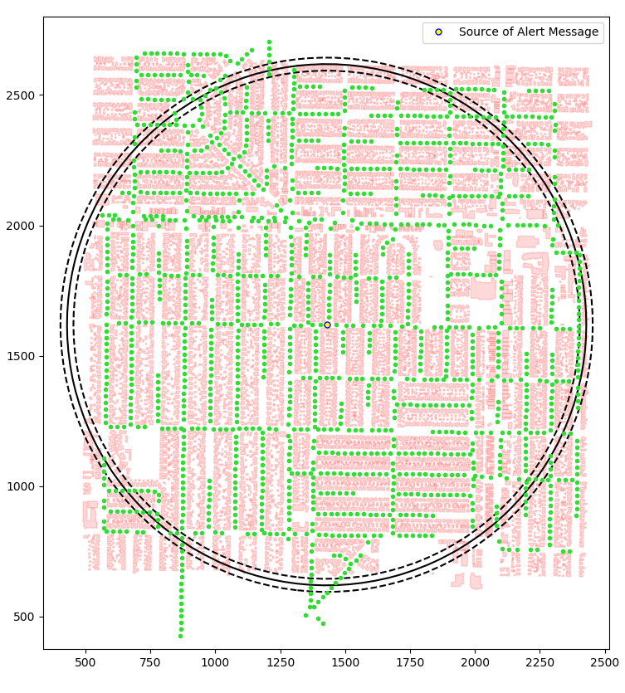
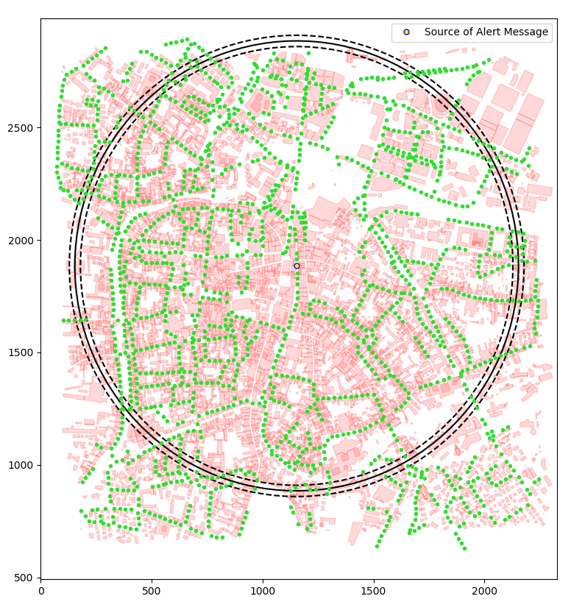
URBAN SCENARIOS
Los Angeles
Padua
5

Slide 13
PRELIMINARY TESTS
Scenario configuration
Scenario name | Padua
Latitude N [°] | 45.4171
Latitude S [°] | 45.3981
Longitude W [°] | 11.8654
Longitude E [°] | 11.8923
Circumference radius [m] | 1000
Distance between vehicles [m] | 5, 15, 25, 35, 45
Number of vehicles | 4975, 2856, 1775, 1318, 1072
Number of simulations | 4500
Simulator configuration
Packet payload size | 100 byte
Frequency [GHz] | 2.4
Channel bandwidth [MHz] | 22
Transmission speed [Mbps] | 11
Transmission powers [dBm] | -7.0, 4.6, 13.4
Transmission ranges [m] | 100, 300, 500
Modulation | DSSS
Propagation loss model | ns3::TwoRayGround
Propagation delay model | ns3::ConstantSpeed
5

Slide 14
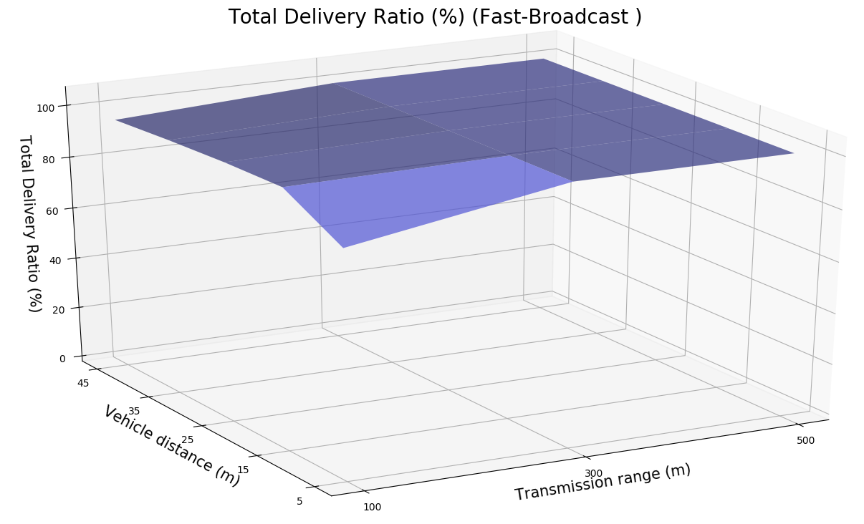
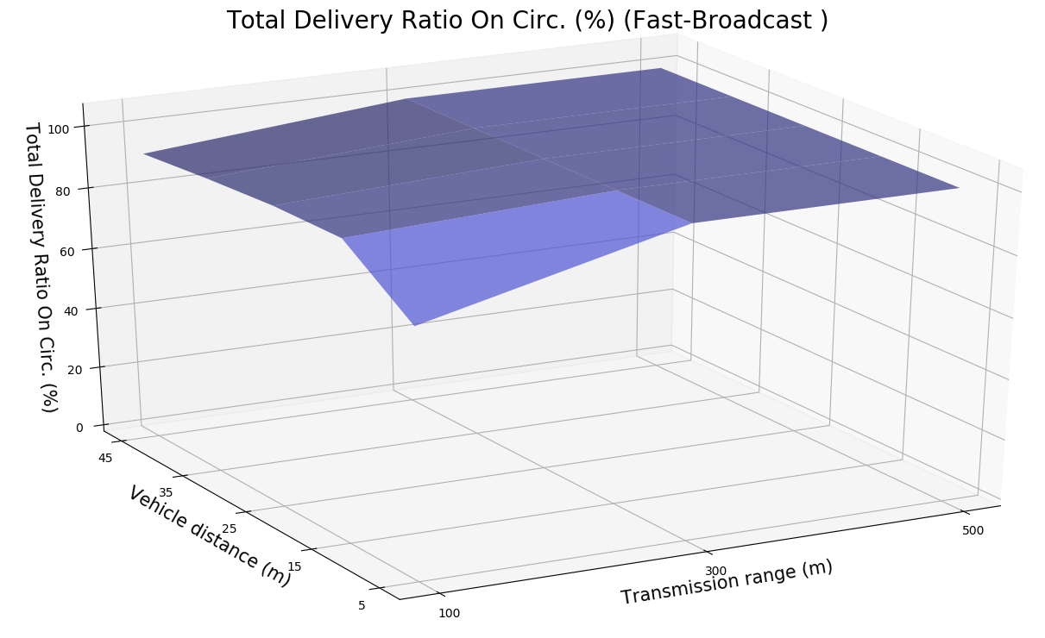
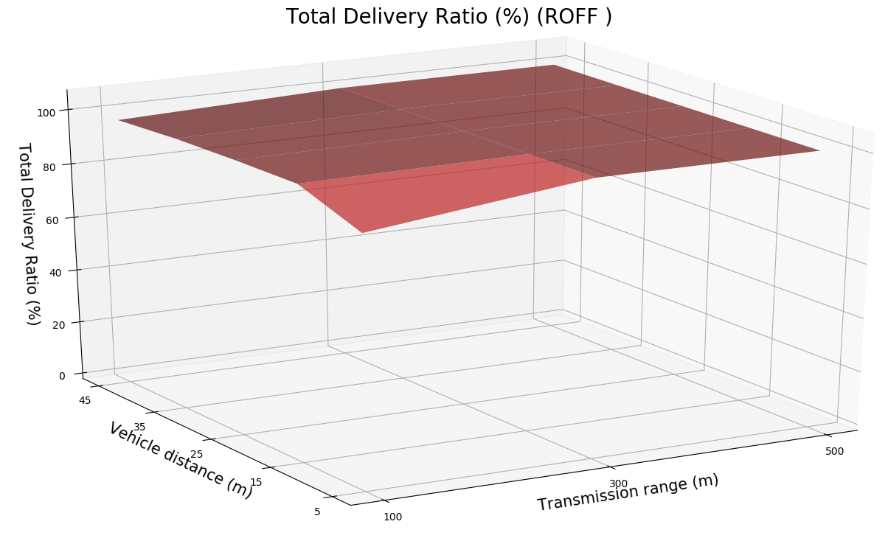
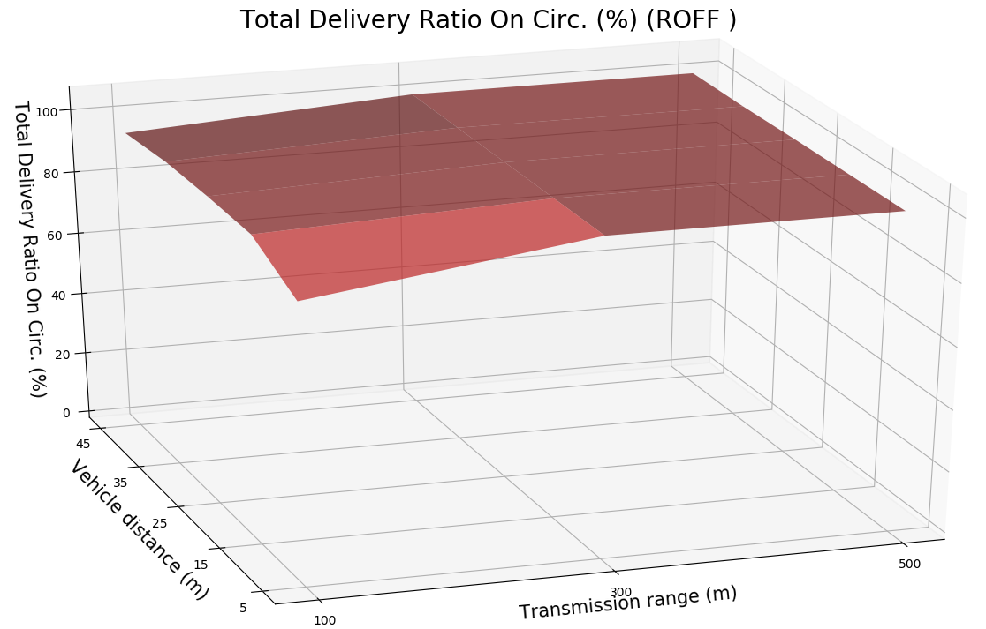
PRELIMINARY TESTS - DELIVERY RATIOS
5

Slide 15
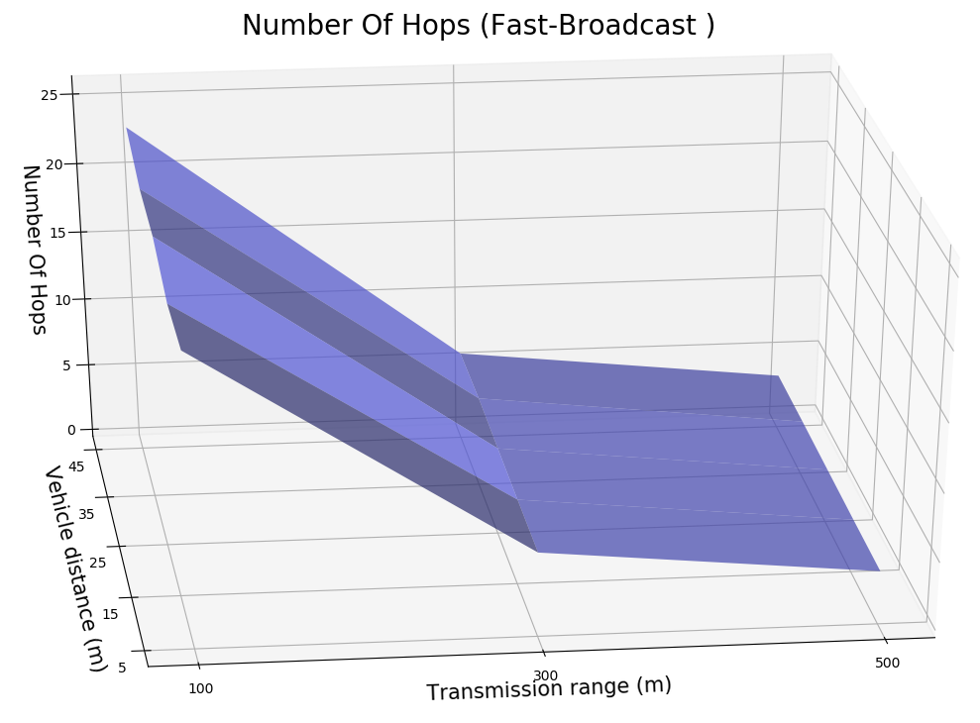
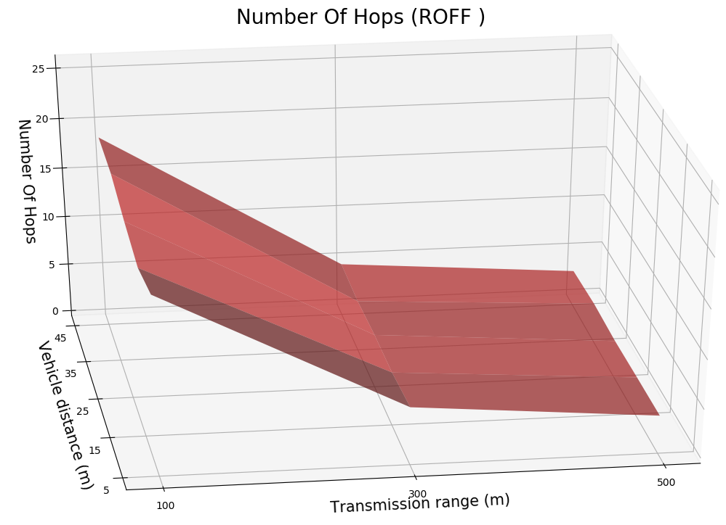
PRELIMINARY TESTS – NUMBER OF HOPS
5

Slide 16
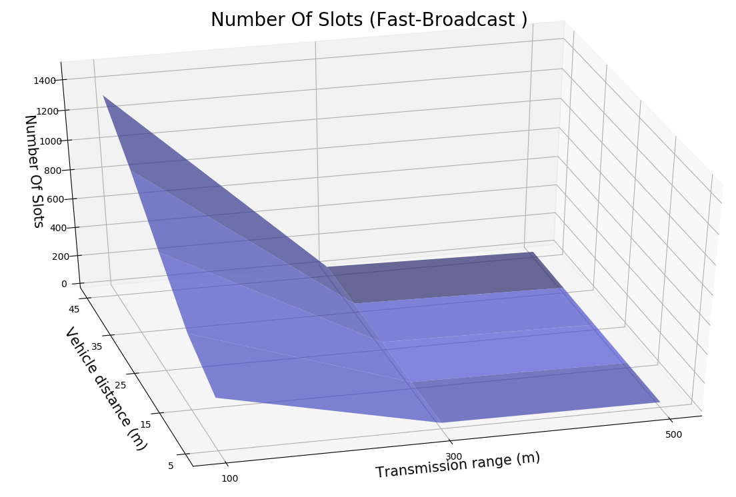
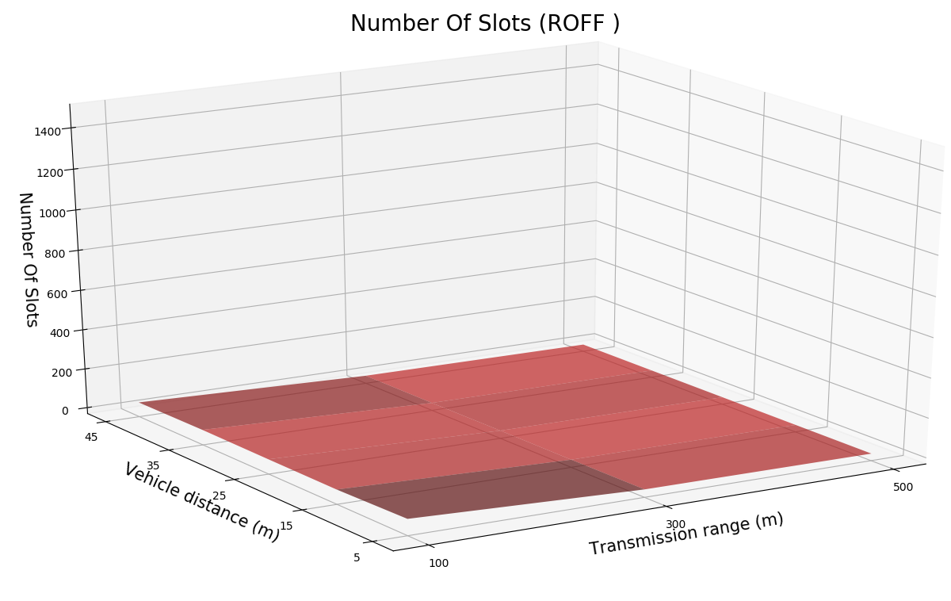
PRELIMINARY TESTS
↑ Coverage: comparable results
↓ Number of hops: ROFF slightly better RISTAMPARE
↓ Number of slots:
5

Slide 17
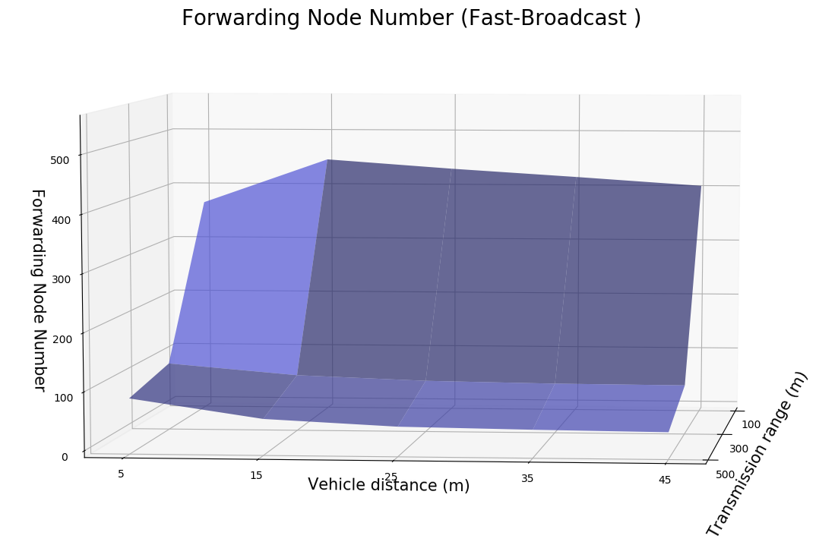
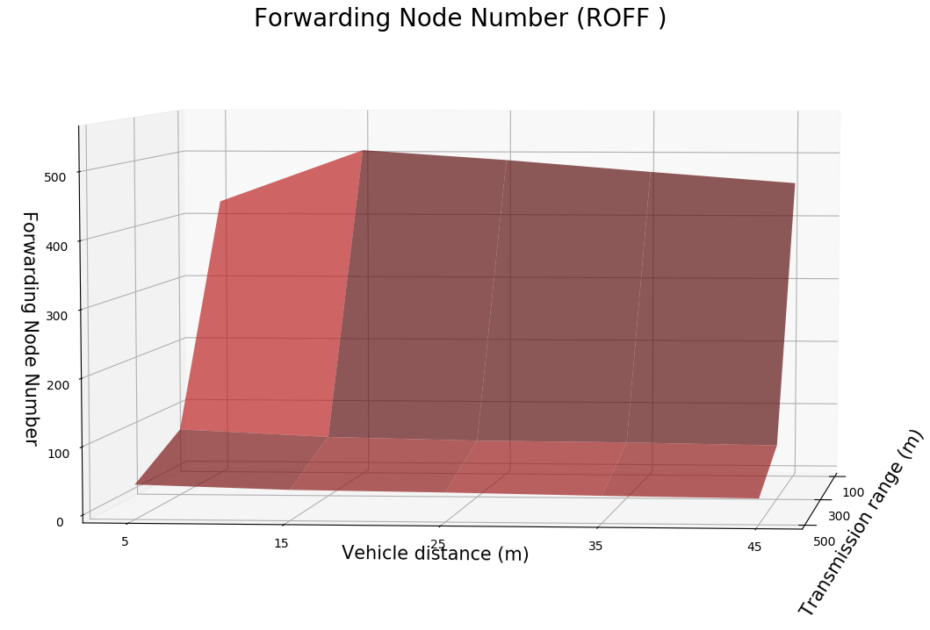
FORWARDING NODE NUMBER↓
5

Slide 18
PADUA URBAN SCENARIO
Scenario configuration
Scenario name | Padua
Latitude N [°] | 45.4171
Latitude S [°] | 45.3981
Longitude W [°] | 11.8654
Longitude E [°] | 11.8923
Circumference radius [m] | 1000
Distance between vehicles [m] | 25
Number of vehicles | 1775
Number of buildings | 6322
Number of simulations | 4500
Simulator configuration
Packet payload size | 100 byte
Frequency [GHz] | 2.4
Channel bandwidth [MHz] | 22
Transmission speed [Mbps] | 11
Transmission powers [dBm] | -7.0, 4.6, 13.4
Transmission ranges [m] | 100, 300, 500
Modulation | DSSS
Propagation loss model | ns3::TwoRayGround
Propagation delay model | ns3::ConstantSpeed
Shadowing model | ns3::ObstacleShadowing
5

Slide 19
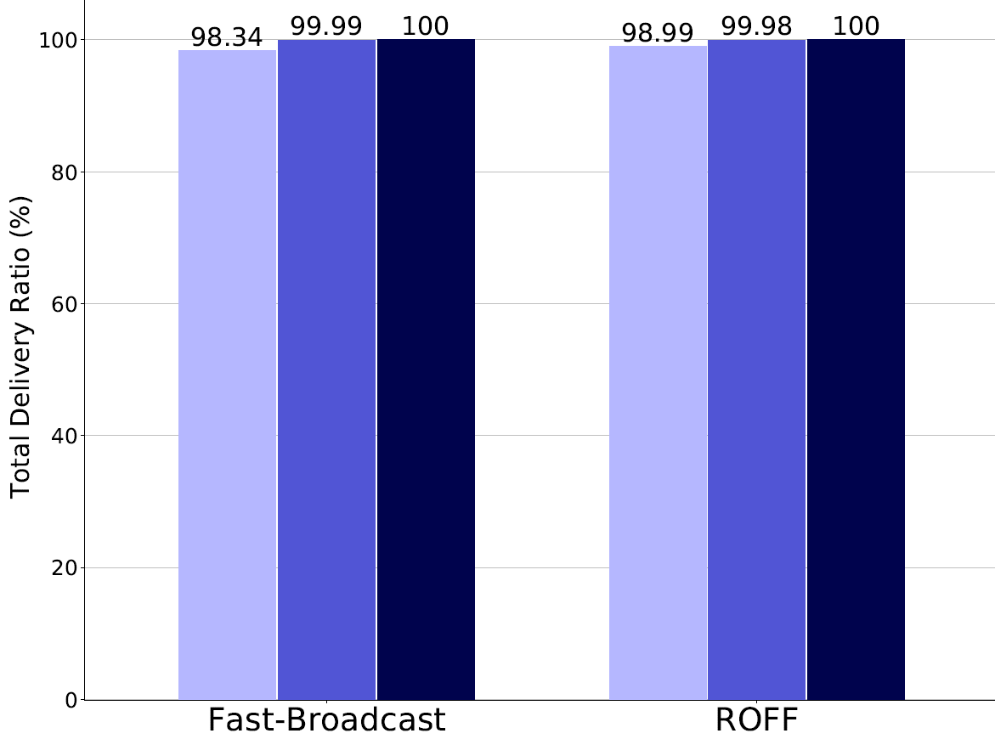
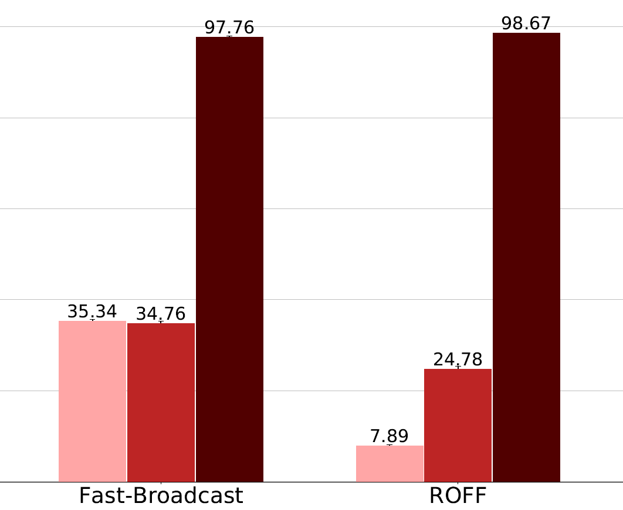






PADUA – COVERAGE ↑
Without buildings
With buildings
5

Slide 20
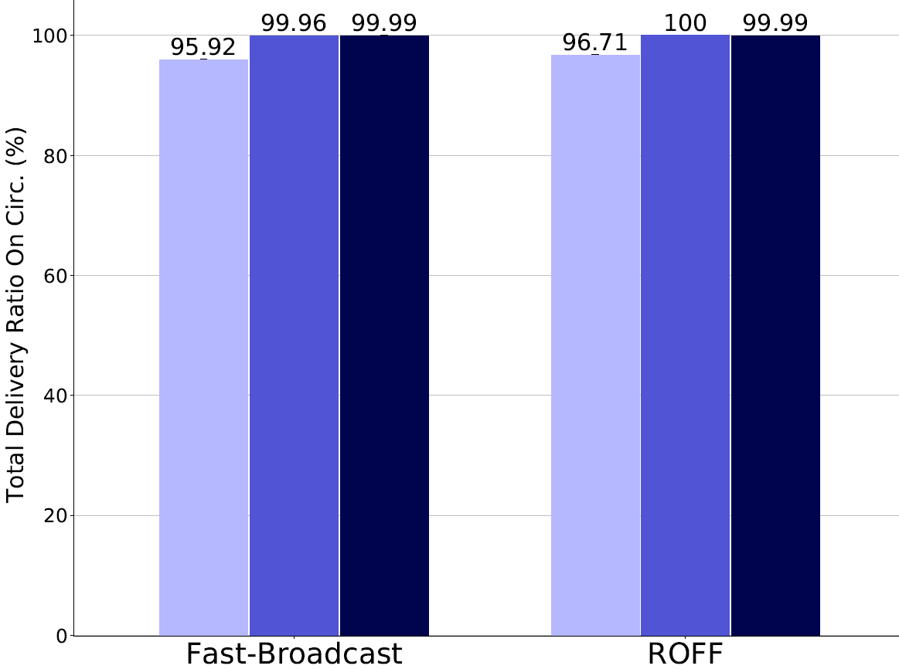
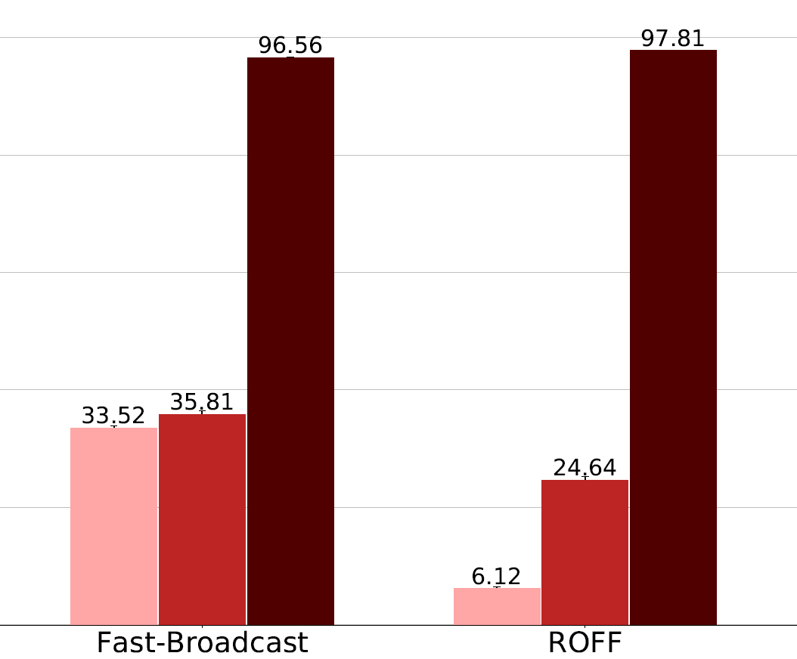
PADUA – TOTAL DELIVERY RATIO ON CIRC.
Without buildings
With buildings
5

Slide 21
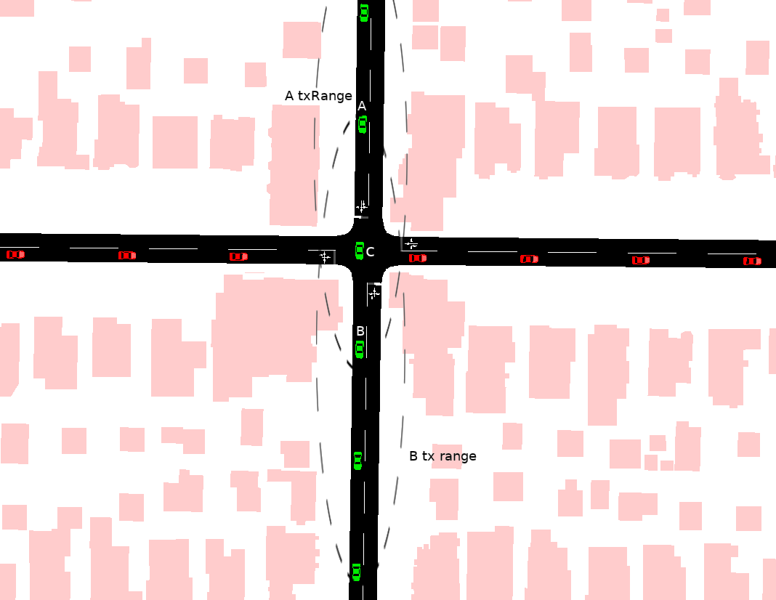
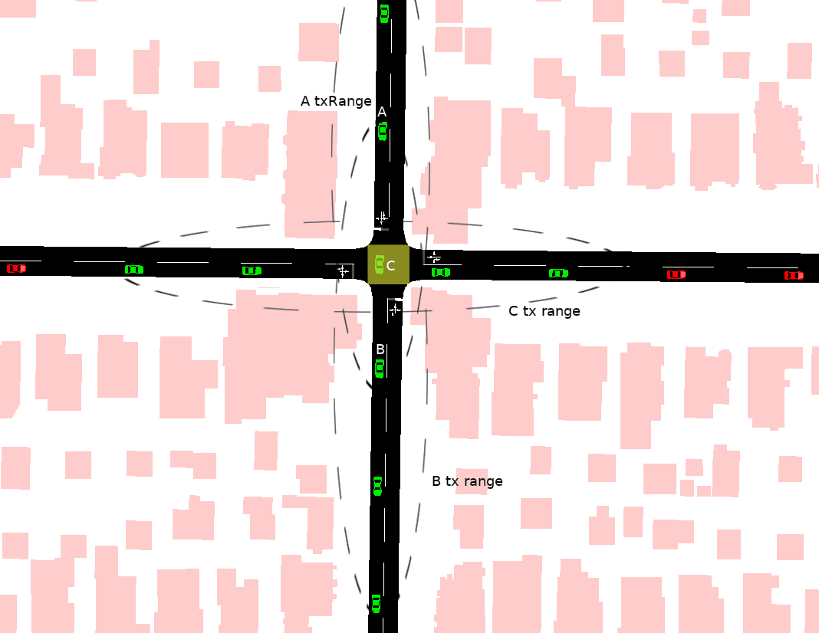
EXPLOITING JUNCTIONS – EXAMPLE
Without junction model
With junction model
5

Slide 22
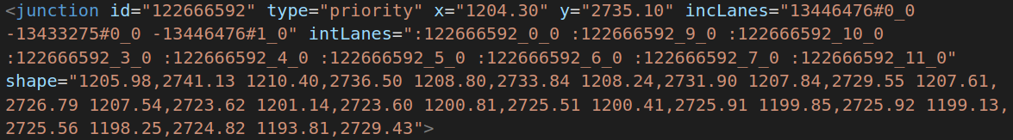
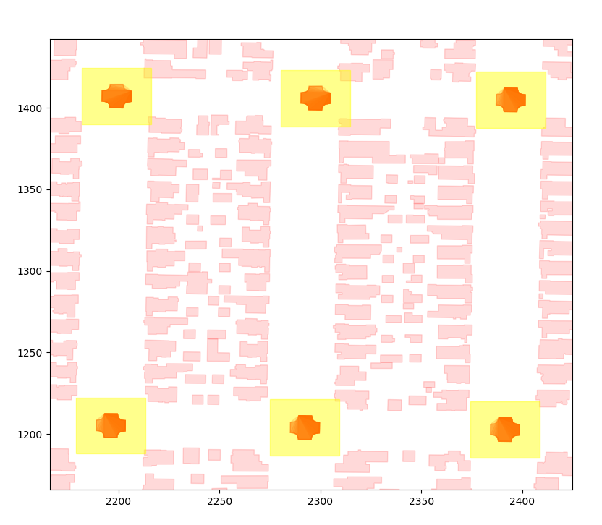
JUNCTION MODEL
Aim: exploit vehicles located within junctions to improve delivery ratios
Identification of junctions via OSM/SUMO tools
20x20m bounding box to extend the polygon
Vehicles within a junction participate in a second contention with other vehicles within the same junction
Extension applicable both to Fast-Broadcast and ROFF
SJ-Fast-Broadcast and SJ-ROFF
5

Slide 23
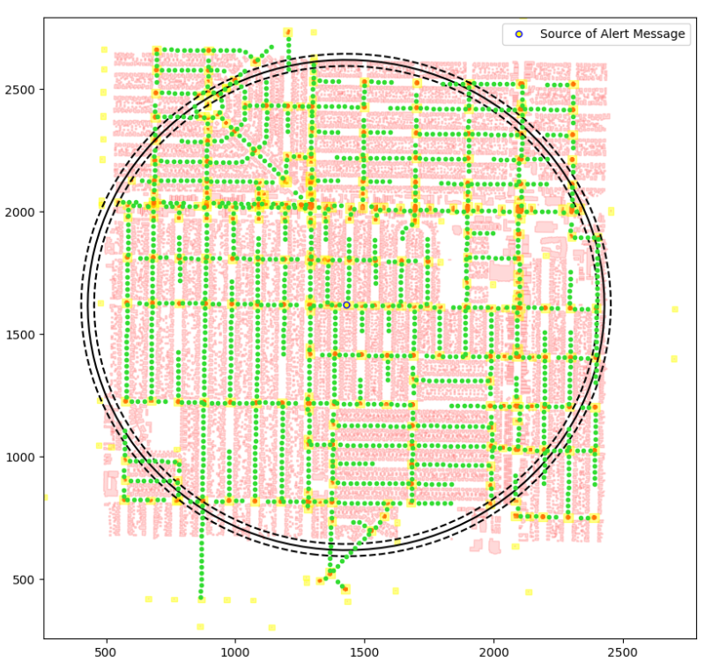
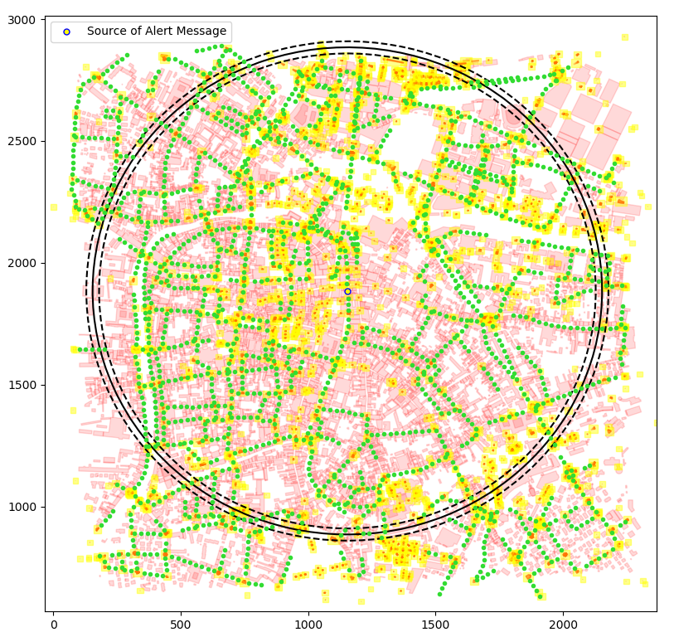
JUNCTION MODEL - SCENARIOS
Los Angeles
Padua
5

Slide 24
PADUA URBAN SCENARIO WITH JUNCTIONS
Scenario configuration
Scenario name | Padua
Latitude N [°] | 45.4171
Latitude S [°] | 45.3981
Longitude W [°] | 11.8654
Longitude E [°] | 11.8923
Circumference radius [m] | 1000
Distance between vehicles [m] | 25
Number of vehicles | 1775
Number of buildings | 6322
Number of junctions | 3231
Number of simulations | 4500
Simulator configuration
Packet payload size | 100 byte
Frequency [GHz] | 2.4
Channel bandwidth [MHz] | 22
Transmission speed [Mbps] | 11
Transmission powers [dBm] | -7.0, 4.6, 13.4
Transmission ranges [m] | 100, 300, 500
Modulation | DSSS
Propagation loss model | ns3::TwoRayGround
Propagation delay model | ns3::ConstantSpeed
Shadowing model | ns3::ObstacleShadowing
5

Slide 25
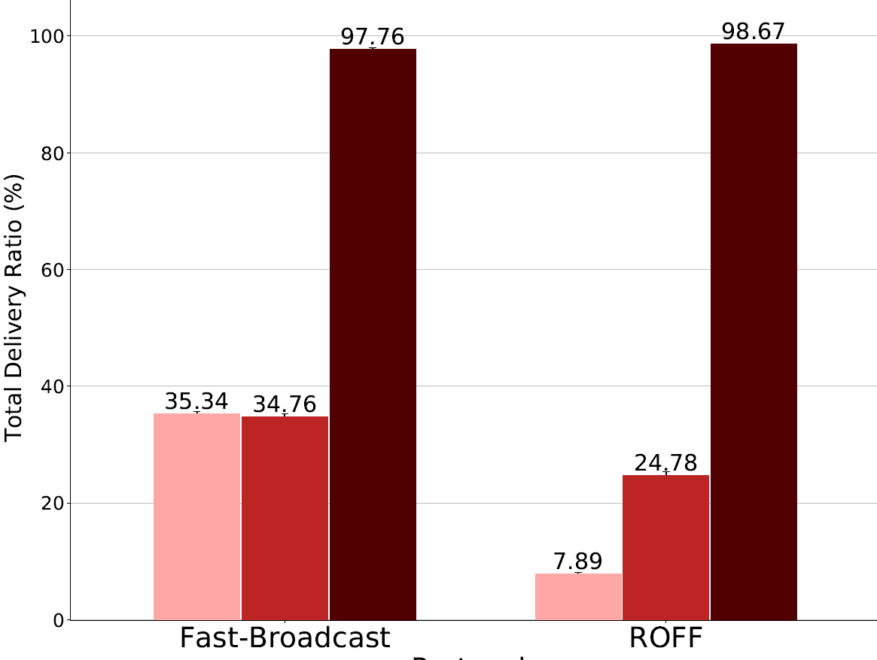
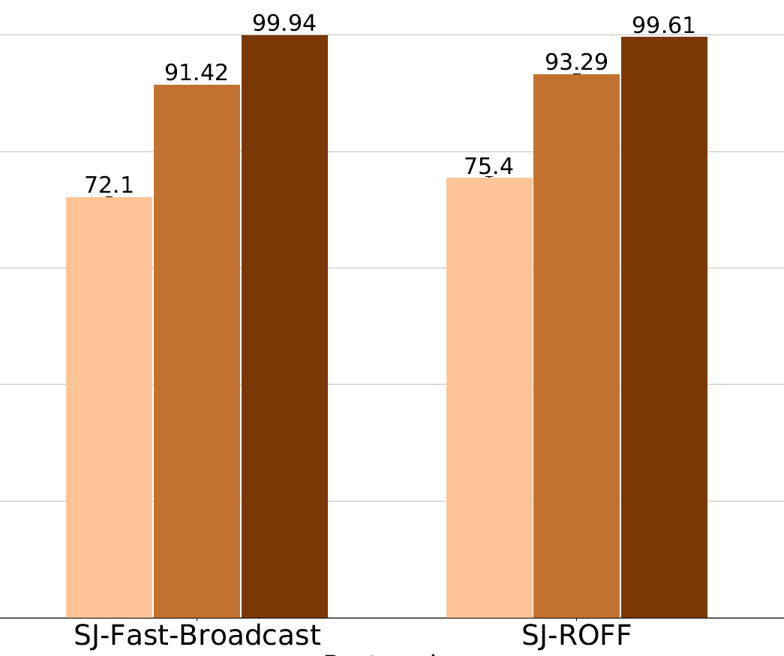



PADUA – COVERAGE WITH JUNCTIONS
Without junctions
With junctions
5

Slide 26
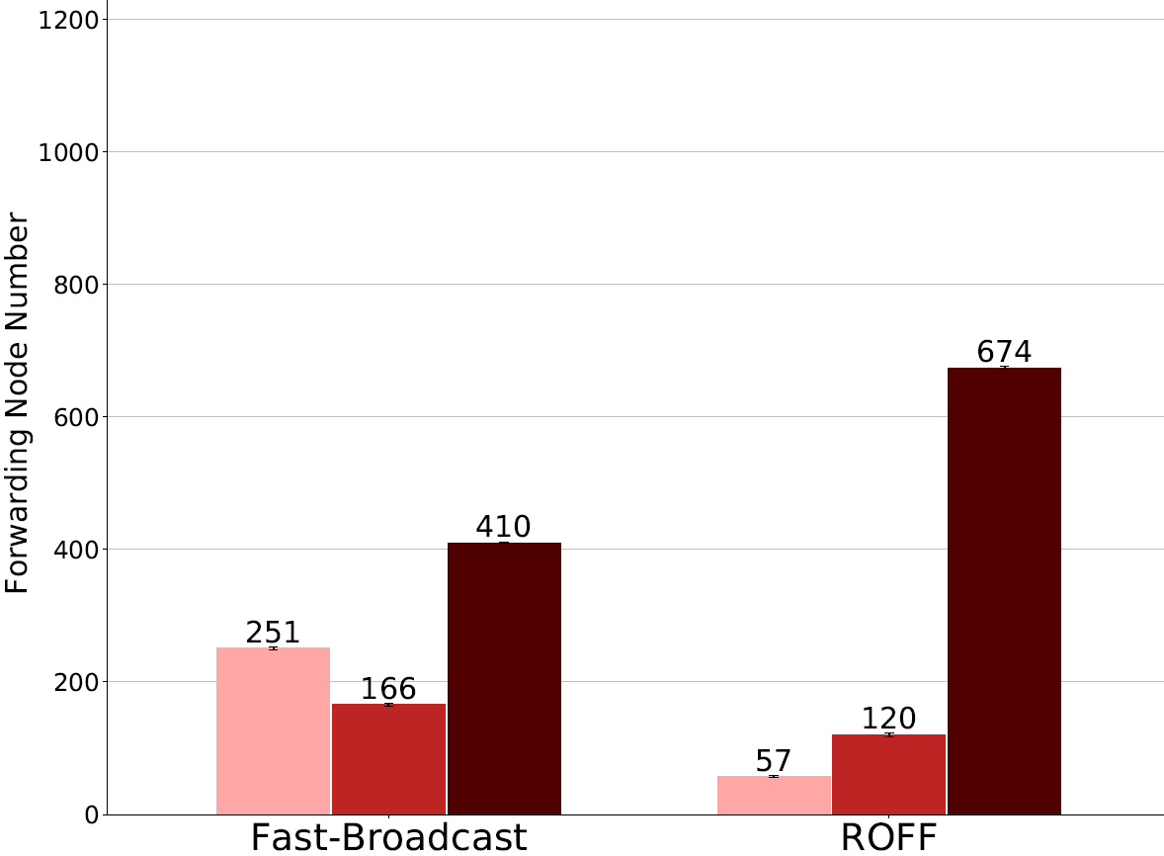
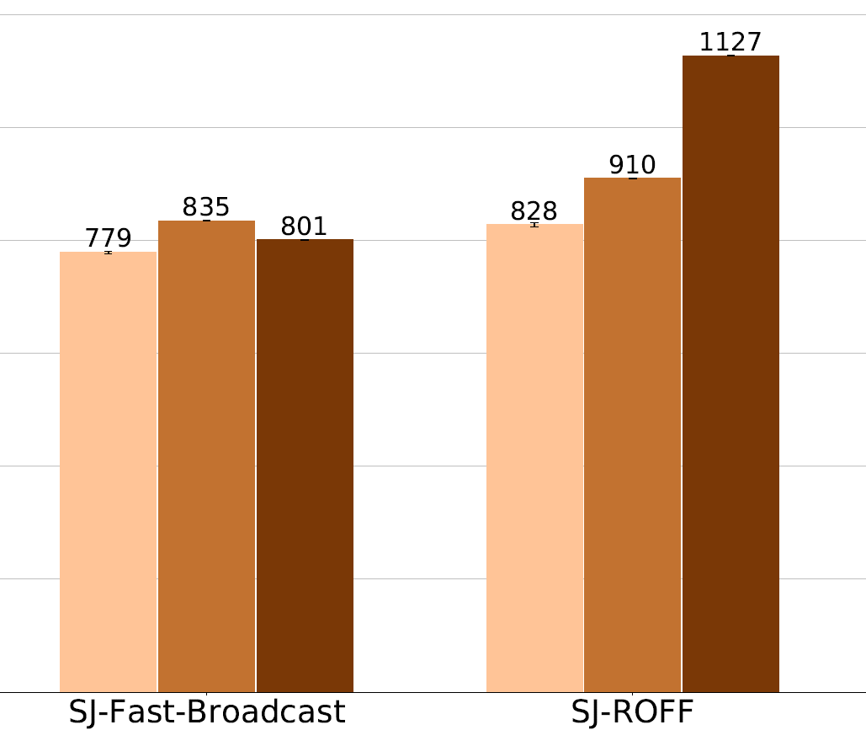
PADUA – FORWARDING NODE NUMBER
Without junctions
With junctions
5

Slide 27
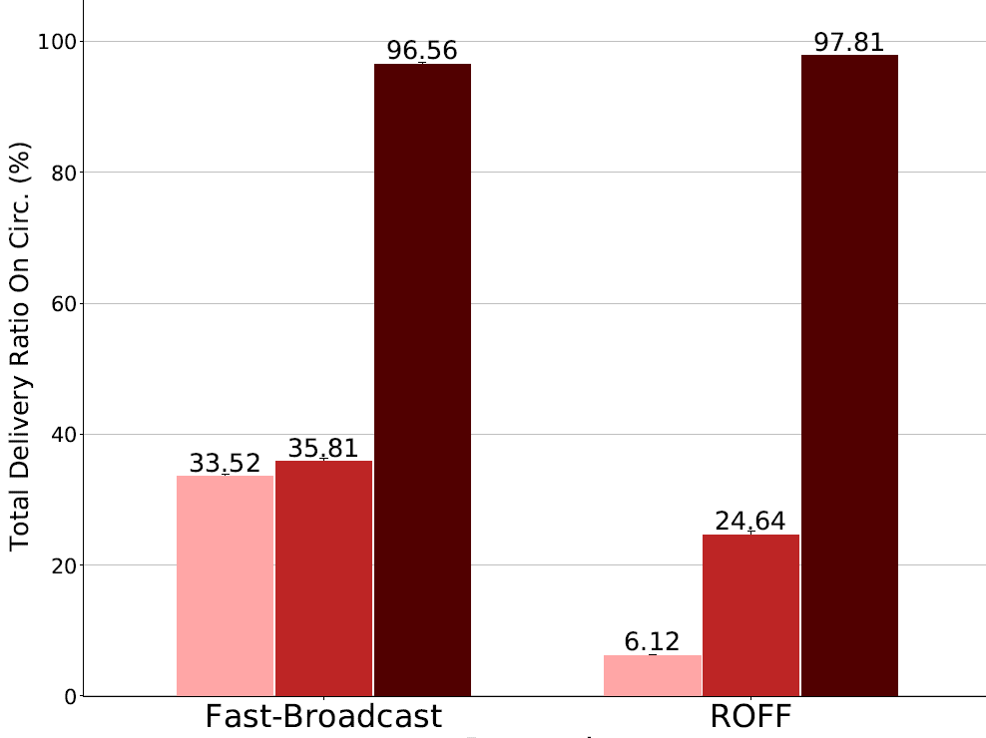
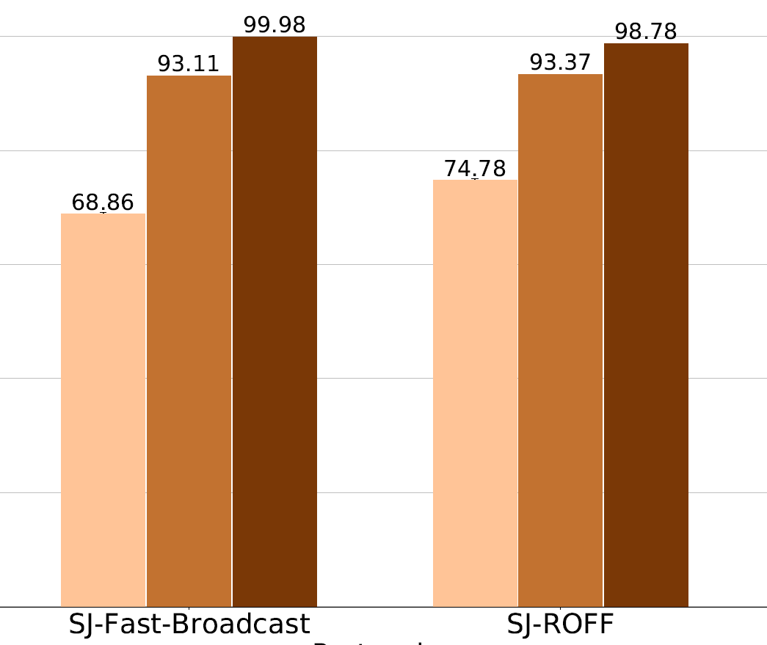
PADUA – TOTAL DELIVERY RATIO ON CIRC.
With buildings, without junctions
With buildings, with junctions
5

Slide 28
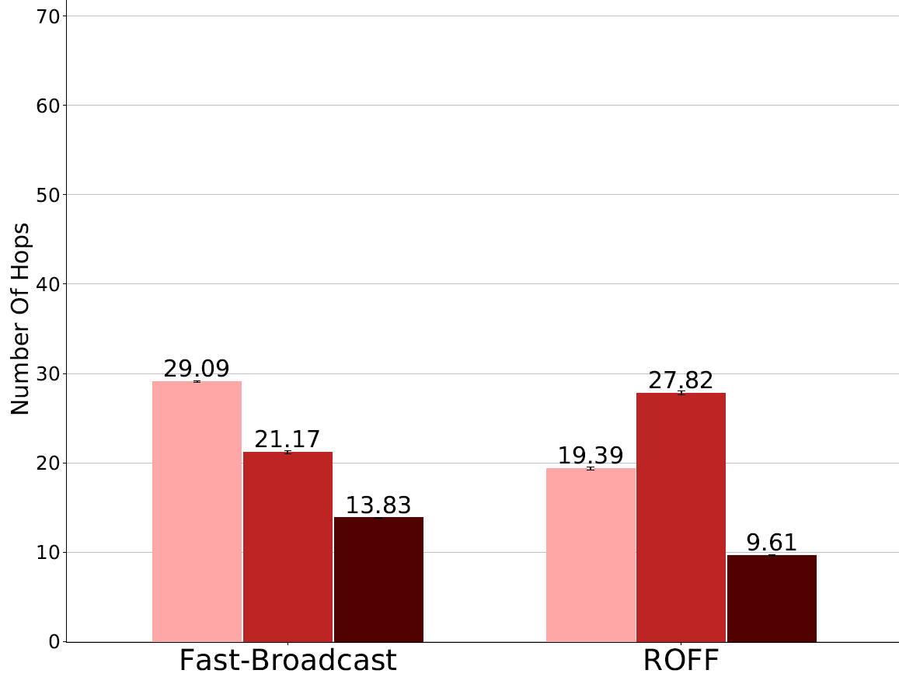
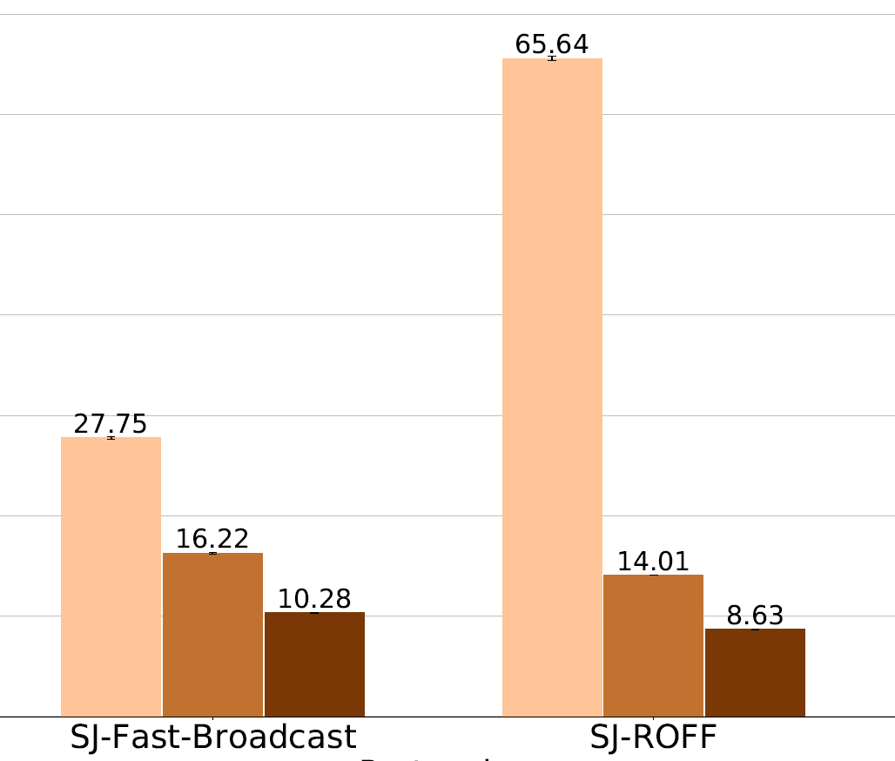
PADUA – NUMBER OF HOPS
With buildings, without junctions
With buildings, with junctions
5

Slide 29
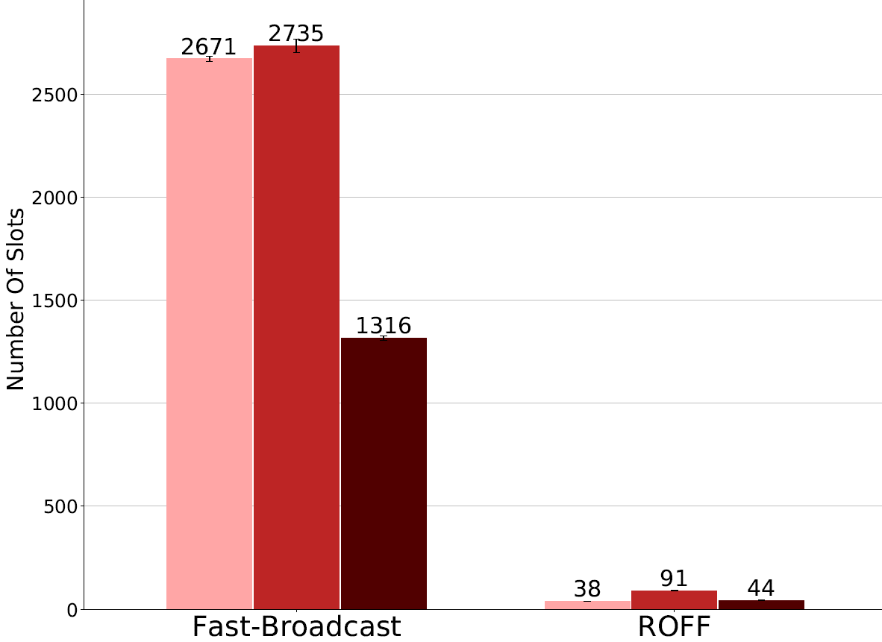
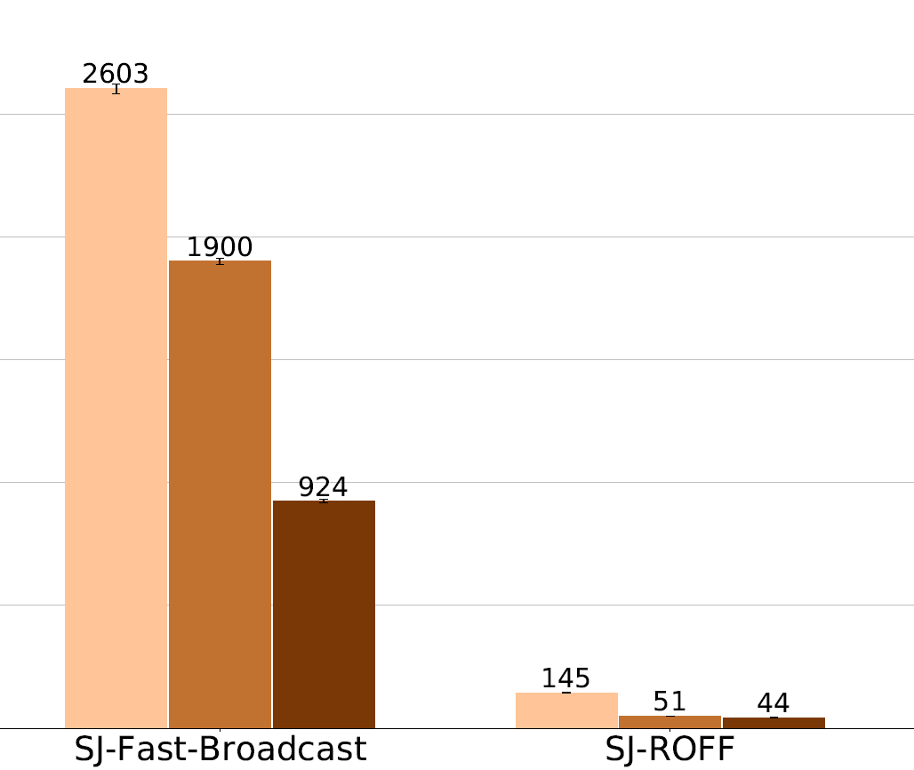
PADUA – NUMBER OF SLOTS
With buildings, without junctions
With buildings, with junctions
5

Slide 30
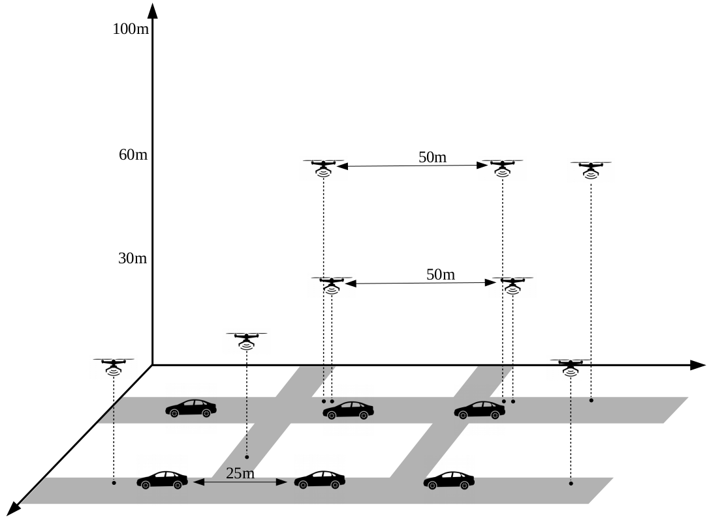
L.A. SMART CITY SCENARIO
Vehicular + drones mixed scenario
Message propagation in 3D
Different buildings configurations
No buildings
5

Slide 31
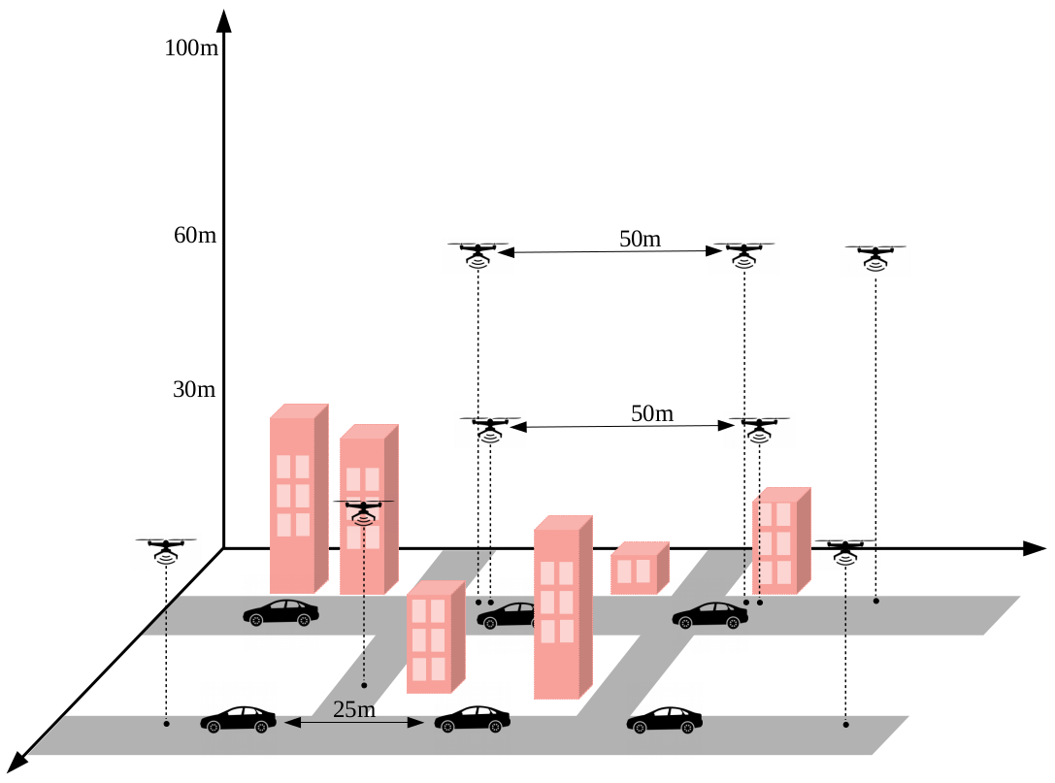
L.A. SMART CITY SCENARIO
Vehicular + drones mixed scenario
Message propagation in 3D
Different buildings configurations
No buildings
Buildings with real heights
5

Slide 32
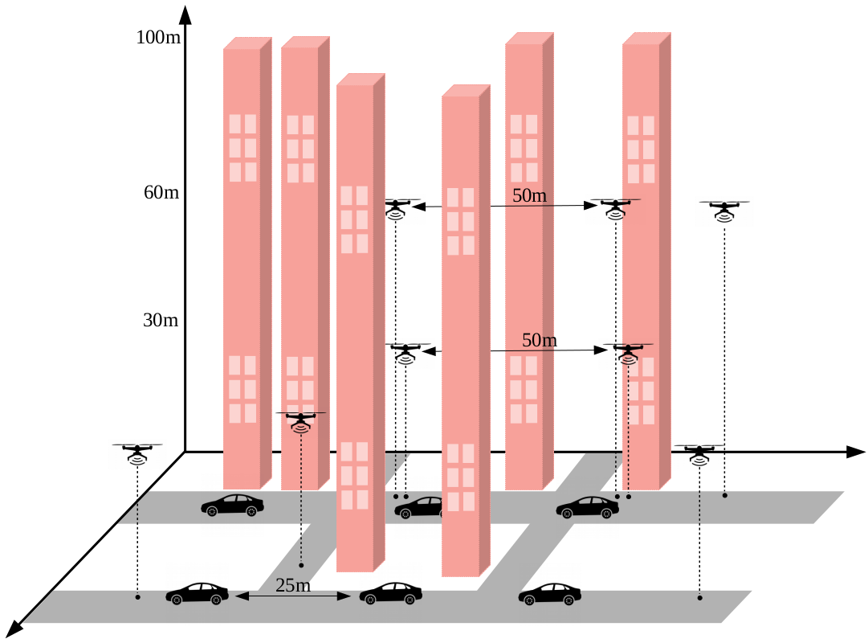
L.A. SMART CITY SCENARIO
Vehicular + drones mixed scenario
Message propagation in 3D
Different buildings configurations
No buildings
Buildings with real heights
Very tall buildings
5

Slide 33
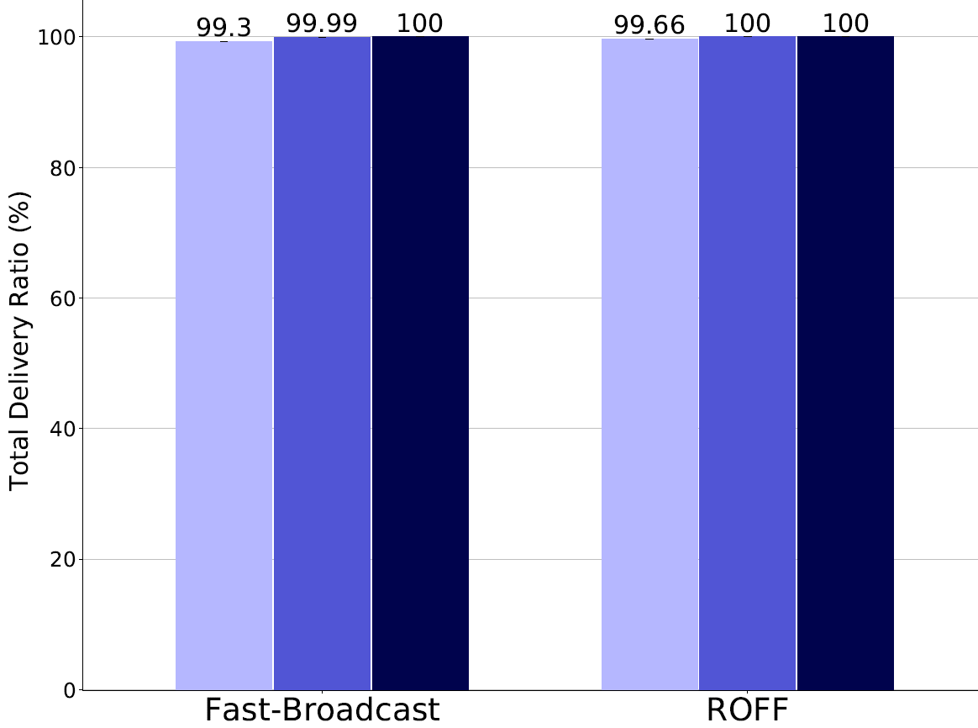
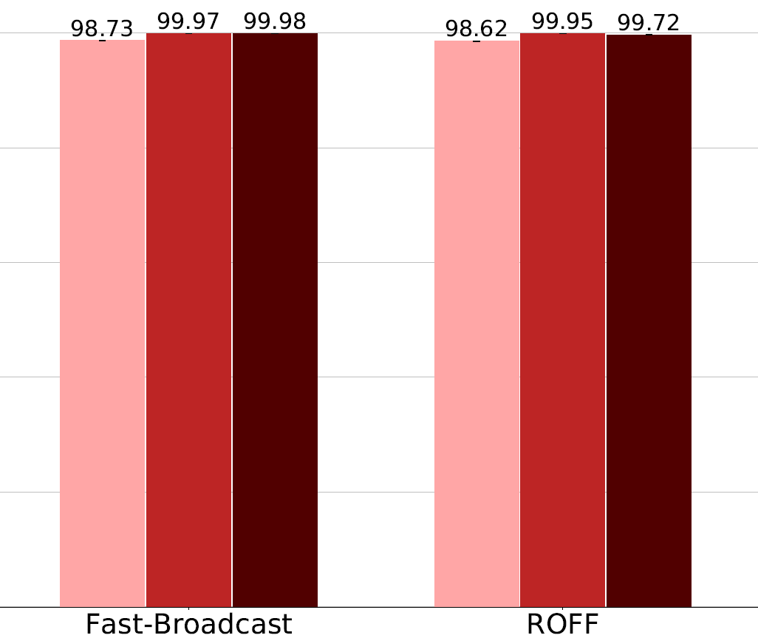
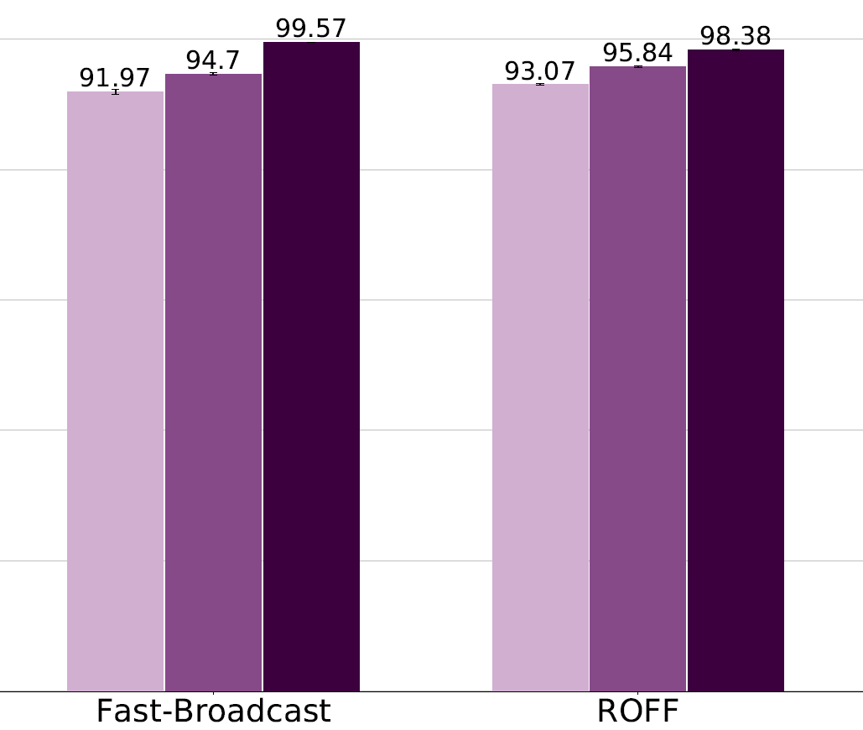



LOS ANGELES – COVERAGE
Without buildings
Real height buildings
Very tall buildings
5

Slide 34
CONCLUSIONS
ROFF introduces a much smaller end-to-end delay (number of slots) than Fast-Broadcast
Greater forwarding number
Determinism and collisions
Number of Hello Messages
SJ-Fast-Broadcast and SJ-ROFF improve delivery ratios greatly
At the cost of more retransmissions
The algorithms work well even in mixed 3D scenarios
5

Slide 35


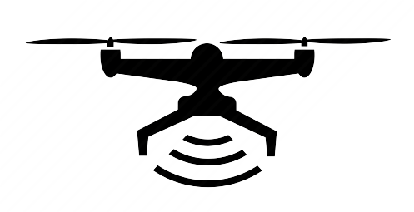
FUTURE WORKS
Dynamic lower and upper bounds for Fast-Broadcast’s waiting time calculation
Based on vehicle density
Junction identification backup mode
Reliance on GPS
Compute angle between received messages to identify vehicles within junctions
Evaluation in more widespread FANETs
5

